Slide 1
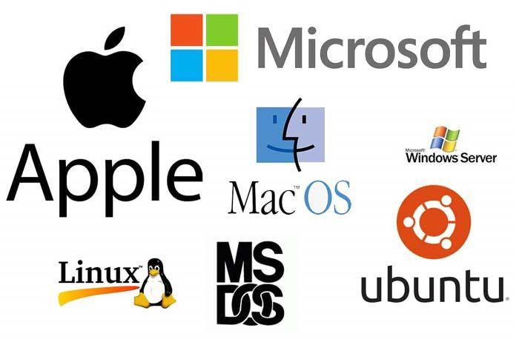

OPERATING SYSTEM
INSY 8223
Faculty of IT
Mr Uzayisenga Emmanuel / Dr Eric NIZEYIMANA / Mr Archimede IRAKOZE/ N. Gilbert
eric.nizeyimana@auca.ac.rw| +250 783 308 544, 0783219523(Gilbert)

Slide 2
Course content
Introduction to Operating Systems
  Definition and functions of an Operating System
  Evolution of operating systems (batch, multiprogramming, time-sharing, real-time, distributed, mobile OS)
  Types of operating systems (Windows, Linux, MacOS, Android, iOS, embedded OS)
  OS as a resource manager
  Operating system architecture (monolithic, layered, microkernel, modular, hybrid)
System Calls and OS Security
  Operating system services
  System calls and APIs
  Virtualization and cloud OS concepts

Slide 3
Cont’
Process Management
  Process concepts (PCB, states, transitions)
  Process scheduling (CPU scheduling criteria, algorithms: FCFS, SJF, Round Robin, Priority, Multilevel Queue)
  Inter-process communication (IPC) and synchronization
  Deadlocks: prevention, avoidance, detection, recovery
Threads and Concurrency
  Threads vs processes
  Multithreading models
  Synchronization tools (mutexes, semaphores, monitors, condition variables)
  Classic synchronization problems (producer-consumer, readers-writers, dining philosophers)

Slide 4
Cont’
Memory Management
  Memory hierarchy and organization
  Address binding, logical vs physical address space
  Swapping and contiguous allocation
  Paging and segmentation
  Virtual memory (demand paging, page replacement algorithms, thrashing)
Storage Management
  File system concepts and implementation
  Directory structures
  File allocation methods (contiguous, linked, indexed)
  Disk scheduling algorithms (FCFS, SSTF, SCAN, C-SCAN, LOOK, C-LOOK)
  RAID levels and reliability

Slide 5
Cont’
I/O Systems
  I/O hardware and organization
  I/O system calls and device drivers
  Interrupt handling
  Disk structure and access methods
  Performance issues in I/O
Security and Protection
  Goals of security and protection
  Authentication and authorization
  Access control lists and capabilities
  Security threats (malware, intrusion, buffer overflow)
  Security mechanisms (firewalls, encryption, auditing)

Slide 6
Cont’
Distributed and Parallel Systems
  Characteristics of distributed OS
  Distributed file systems and shared memory
  Client-server and peer-to-peer models
  Parallel processing and multiprocessor systems
  Cloud and virtualization in OS
Case Studies
  Unix/Linux architecture and commands
  Windows architecture
  Mobile operating systems (Android, iOS)
  Comparative analysis of OS types

Slide 7
Cont’
Practical Laboratory (Hands-On)
  Basic Linux/Unix shell commands
  Process and memory management experiments
  File operations and permissions
  Scheduling algorithms implementation in C/Python
  Simulating page replacement and disk scheduling
Assessment Components
  Assignments
  Lab work
  Quiz
  Exams (Mid-term and Final)

Slide 8
Introduction to Operating Systems
  Definition and functions of an Operating System
  Evolution of operating systems (batch, multiprogramming, time-sharing, real-time, distributed, mobile OS)
  Types of operating systems (Windows, Linux, MacOS, Android, iOS, embedded OS)
  OS as a resource manager
  Operating system architecture (monolithic, layered, microkernel, modular, hybrid)

Slide 9
Learning outcome
  Define an Operating System and explain its purpose in a computer system.
  Describe the major functions of an Operating System, including process management, memory management, file management, device management, and security.
  Explain the historical evolution of operating systems from batch systems to modern mobile and distributed systems.
  Classify the different types of operating systems (Windows, Linux, MacOS, Android, iOS, and embedded OS) and identify their applications.
  Illustrate how the Operating System functions as a resource manager, ensuring efficient allocation and control of CPU, memory, storage, and I/O devices.
  Compare the strengths and limitations of different operating systems in relation to usability, performance, and real-world applications.

Slide 10
Why Should I Study Operating Systems?
Foundation of Computer Science
  The OS is the backbone of computing — it connects hardware and software.
  Understanding OS concepts helps you grasp how computers really work.
Efficient Problem Solving
  Many programming and system issues (e.g., memory leaks, deadlocks, performance bottlenecks) are directly related to OS principles.
  By learning OS, you’ll be better equipped to debug and optimize programs.
Practical Relevance
  Every device you use — laptops, smartphones, ATMs, cars, IoT devices — runs on an OS.
  Knowledge of OS allows you to understand, configure, and secure these systems.

Slide 11
Cont’
Career Advantage
  Jobs in software development, cybersecurity, networking, cloud computing, and AI all require OS knowledge.
  Employers value engineers who understand what’s happening under the hood.
Bridge to Advanced Topics
  OS concepts are the foundation for distributed systems, cloud computing, virtualization, and real-time systems.
  Studying OS prepares you for advanced courses and research.
Hands-On Skills
  Learning OS involves working with Linux/Unix commands, writing system-level programs, and simulating scheduling or memory algorithms.
  These practical skills are highly transferable.

Slide 12
What is an operating System?
Operating systems is software platform that other applications run on top of.
An operating system is a program that acts as an interface between the user and the computer hardware and controls the execution of all kinds of programs.
It hides the complexity of hardware from users and applications.
Provides a user interface (Command Line Interface or Graphical User Interface).
Ensures efficient utilization of CPU, memory, storage, and I/O devices.

Slide 13
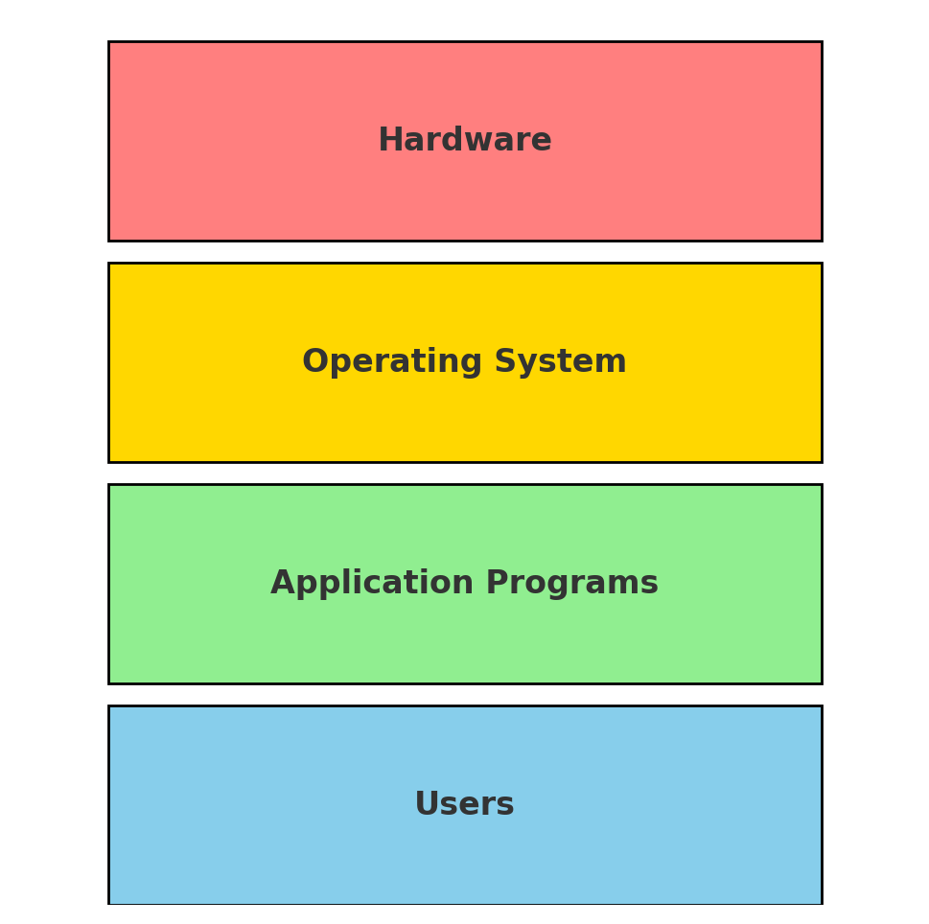
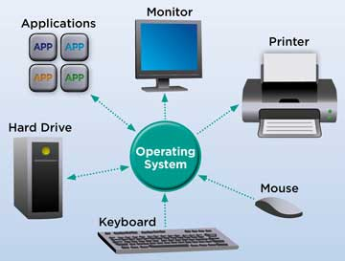

Slide 14
Examples
Desktop/Laptop OS: Windows, Linux, MacOS
Mobile OS: Android, iOS
Embedded OS: FreeRTOS, Embedded Linux

Slide 15
Goals of an Operating System
1. Convenience
Make the computer system easy to use for users and programmers.
Provide user interfaces (CLI, GUI) for interaction.
Hide the complexity of hardware operations.
2. Efficiency
Ensure optimal utilization of hardware resources such as CPU, memory, storage, and I/O devices.
Reduce idle time and maximize throughput.
Manage multiple processes fairly and effectively.

Slide 16
Count’
3. Reliability & Stability
Ensure the system runs correctly without frequent crashes.
Handle errors gracefully and recover from failures.
Provide isolation between processes so one faulty program doesn’t crash the whole system.
4. Security & Protection
Protect data and system resources from unauthorized access.
Manage authentication, access control, and encryption.
Provide process isolation to prevent interference.

Slide 17
Cont’
5. Resource Sharing
Allow multiple users and applications to share system resources safely.
Enable multi-user and multiprogramming environments.
6. Scalability & Adaptability
Support new hardware, technologies, and applications.
Adapt to different environments: desktops, servers, mobile, IoT, cloud, real-time systems.

Slide 18
Computer System Components
1. Hardware
  The physical components of the computer.
    CPU (Processor): Executes instructions.
    Memory (RAM): Stores data and instructions temporarily.
    Storage: Hard drives, SSDs for long-term storage.
    I/O Devices: Keyboard, mouse, display, printers, network cards.
2. Operating System (OS)
    The system software that controls and coordinates the use of hardware among users and applications.
    Acts as a resource manager and interface between hardware and software.
3. System & Application Programs
    System Programs: Provide basic functions (compilers, assemblers, utilities, libraries).
    Application Programs: Run specific tasks for users (word processors, web browsers, databases, games).
4. Users
  People or other systems that interact with the computer.
    End-users (students, professionals, businesses)
    Programs acting as users (automated scripts, servers, AI agents).

Slide 19
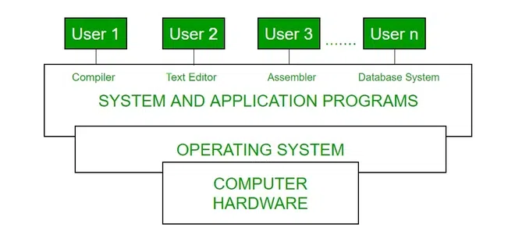
Abstract View of System

Slide 20
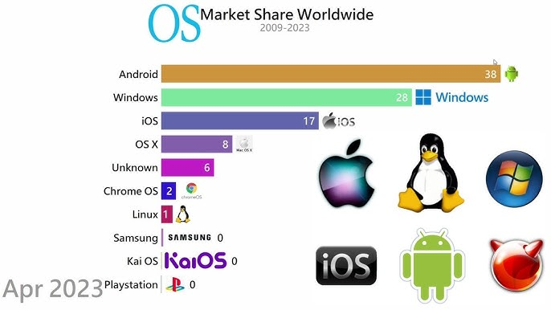

Slide 21
Comparison of Operating Systems
OS Type | Strengths | Limitations | Applications
Windows | User-friendly, wide software support | Vulnerable to malware, less customizable | Desktop PCs, office use, gaming
Linux | Secure, stable, open-source | Steeper learning curve, fewer commercial apps | Servers, developers, scientific computing
MacOS | Smooth UI, strong multimedia support | Expensive hardware, limited customization | Design, multimedia, professional users
Android/iOS | Mobile-optimized, large app ecosystem | Limited hardware control, OS fragmentation (Android) | Smartphones, tablets, mobile apps
Embedded OS | Lightweight, real-time capabilities | Limited flexibility, specific to hardware | IoT devices, appliances, industrial systems

Slide 22
Goals of an Operating System
Convenience → Make computers easy to use for users & programmers
Efficiency → Optimize use of CPU, memory, storage, and I/O devices
Reliability & Stability → Ensure system runs smoothly with error recovery
Security & Protection → Safeguard data and resources from unauthorized access
Resource Sharing → Allow multiple users & processes to share resources safely
Scalability & Adaptability → Support new hardware, applications, and environments

Slide 23
Characteristics of an Operating System
Multiprogramming – Runs multiple programs in memory at once
Multitasking – Executes several tasks simultaneously
Multiprocessing – Uses multiple CPUs/cores for faster processing
Multi-user Support – Allows many users to share the system
Multithreading – Splits a process into multiple execution threads

Slide 24
Count’
Real-time Operation – Responds immediately to critical tasks
Security & Protection – Prevents unauthorized access, ensures privacy
Networking Capability – Supports communication & resource sharing
File System Management – Organizes and controls data storage
User Interface – Provides CLI or GUI for user interaction

Slide 25
Operating System as a Resource Manager
CPU Management:
  Schedules processes efficiently
  Handles multitasking and process priorities
Memory Management:
  Allocates and deallocates RAM
  Supports virtual memory and paging
Storage & File Management:
  Organizes files and directories
  Controls access permissions and ensures data integrity
I/O Device Management:
  Manages input/output devices via drivers
  Handles buffering, spooling, and device sharing

Slide 26
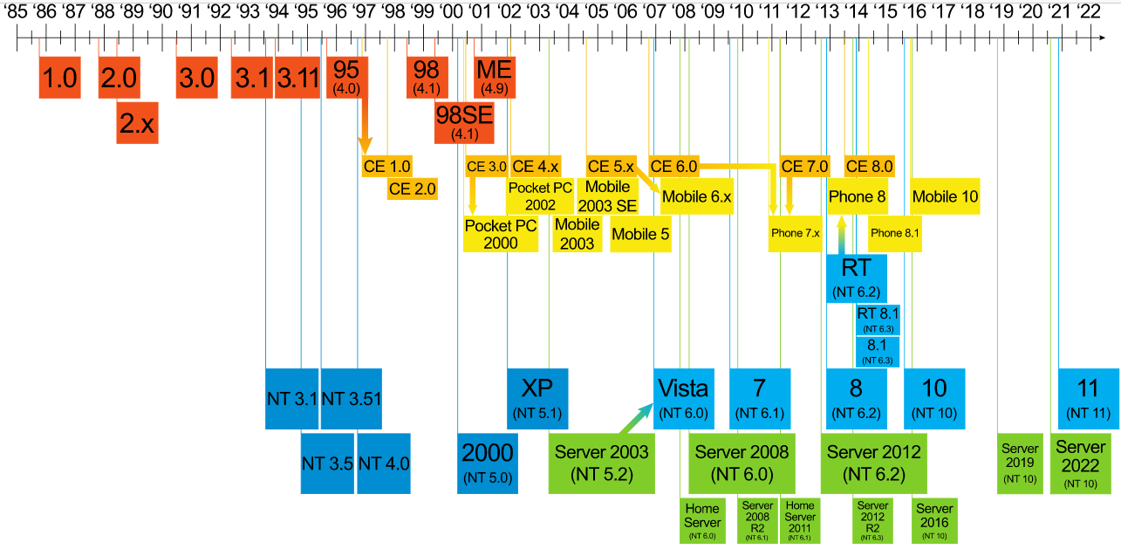
WINDOWS FAMILY TREE

Slide 27
Purpose of an Operating System
All computers rely on an operating system (OS) to provide the interface for interaction between users, applications, and hardware.
The operating system boots the computer and manages the file system.
Almost all modern operating systems can support more than one user, task, or CPU.

Slide 28
Basic functions of modern operating systems
Process Management: Creates, schedules, and terminates processes.
Memory Management: Allocates RAM; supports virtual memory.
File System Management: Organizes files and directories; controls access.
Device (I/O) Management: Manages input/output devices via drivers.
Security & Protection: Ensures authentication, access control, and data safety.
User Interface (UI): Provides CLI and/or GUI for user interaction.
Networking & Communication: Manages network connections and resources.
Error Detection & Handling: Detects and corrects system errors.

Slide 29
Control Hardware Access (Device Management)
The operating system manages the interaction between applications and the hardware.
To access and communicate with the hardware, the operating system installs a device driver for each hardware component.
A device driver is a small program written by the hardware manufacturer and supplied with the hardware component.
When the hardware device is installed, the device driver is also installed, allowing the OS to communicate with the hardware component.

Slide 30
Cont’
The assignment of system resources and the installation of drivers can be automated using Plug and Play (PnP) technology.
PnP was first introduced in Windows 95 to make hardware installation easier. Today, all modern operating systems support PnP.
With PnP, the operating system:
  Automatically detects PnP-compatible hardware.
  Installs the appropriate driver for the device.
  Configures the device and updates the system registry.
  Note: The registry is a database that stores information about applications, users, hardware, network settings, and file types, helping the system manage and organize resources efficiently.

Slide 31
File and Folder Management
File Management
  Create, open, read, write, delete files
  Rename, copy, move files
  Manage file attributes (name, size, type, date)
  Control file access permissions
Folder (Directory) Management
  Create and delete folders
  Organize files into directories/subdirectories
  Navigate using paths (absolute & relative)
  Apply folder-level sharing & permissions

Slide 32
File Management Activities of an Operating System
The Operating System performs the following activities for file management:
File Creation and Deletion
  Allows users and programs to create, delete, and modify files.
Directory Management
  Creates, organizes, and manages directories (folders).
  Supports hierarchical structure for easier navigation.
File Manipulation
  Provides operations like read, write, append, copy, rename, and move files.

Slide 33
Cont’
File Access Control
  Controls permissions (read, write, execute).
  Ensures only authorized users can access certain files.
File Storage Management
  Allocates and deallocates space on storage devices.
  Keeps track of free and used space.
File Backup and Recovery
  Supports backup systems.
  Helps recover data in case of failure or corruption.
File Sharing
  Allows multiple users/programs to access files concurrently.
  Provides synchronization and locks to prevent conflicts.

Slide 34
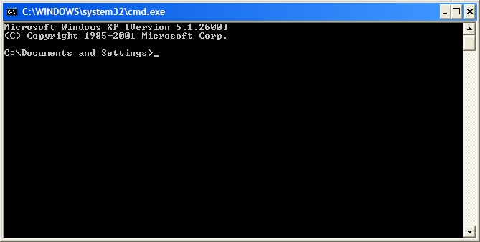
User Interface in Operating Systems
The User Interface (UI) is the part of the OS that allows users to interact with the computer system.
Types of User Interfaces
Command-Line Interface (CLI)
  Text-based interaction (e.g., MS-DOS, Linux terminal)
  Requires typing commands
  Powerful but less user-friendly

Slide 35
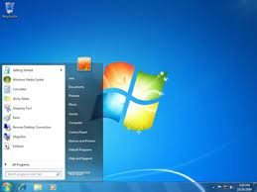
Graphical User Interface (GUI)
Uses windows, icons, menus, and pointers (WIMP)
Examples: Windows, macOS, Linux (Ubuntu GUI)
Easy for beginners, intuitive

Slide 36
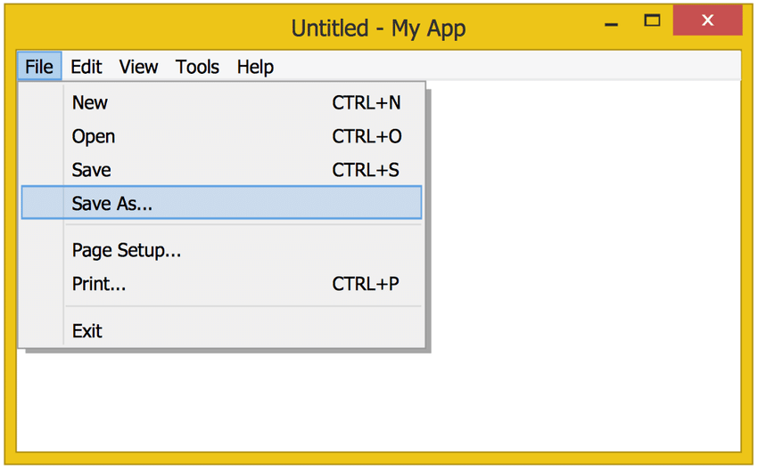
Menu-Driven Interface
Interaction through menus and options
Example: ATMs, mobile phones, BIOS setup

Slide 37

Touch User Interface
Interaction via touch gestures on screens
Used in smartphones, tablets, kiosks

Slide 38

Voice-Based & Natural UI
Interaction through speech or natural language
Examples: Siri, Alexa, Google Assistant

Slide 39
Application Management in Operating Systems
The OS manages applications to ensure smooth execution and resource use.
Key Functions
Program Execution
  Loads applications into memory and runs them.
  Provides environment for execution.
Resource Allocation
  Assigns CPU, memory, files, and I/O devices to applications.
  Balances resources among multiple apps.
Process Coordination
  Manages multitasking and communication between applications.
  Prevents conflicts (deadlocks).

Slide 40
Cont’
Installation & Updates
  Provides mechanisms to install, configure, and update applications.
Monitoring & Termination
  Tracks application performance and usage.
  Allows safe shutdown/termination of apps.
Security & Protection
  Controls access permissions for applications.
  Isolates apps to prevent interference.

Slide 41
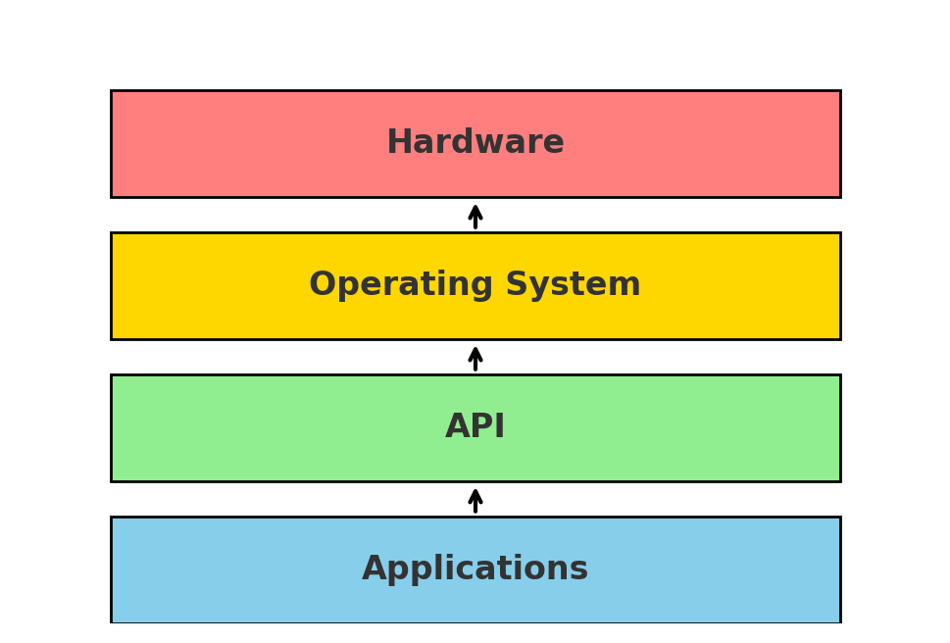

Slide 42
API (Application Programming Interface) in Operating Systems
An API is a set of predefined functions and routines provided by the OS that allows applications to communicate with the hardware and system resources without knowing the hardware details.
Key Points:
Interface for Applications
  Provides standard calls to request OS services (e.g., file access, process control).
Abstraction of Hardware
  Developers don’t need to manage hardware directly; OS handles it.
Examples of OS APIs:
  Windows API: Create windows, read/write files, access devices.
  POSIX API (Unix/Linux): fork(), exec(), open(), read(), write().
Benefits:
  Simplifies programming.
  Improves portability of applications across different hardware.
  Ensures security and proper resource management.

Slide 43
API Activities in Operating Systems
An API (Application Programming Interface) allows applications to request services from the OS. Its main activities include:
Resource Requests
  Request access to CPU, memory, storage, and I/O devices.
  Example: open(), read(), write() system calls.
Process Management
  Create, execute, suspend, resume, or terminate processes.
  Example: fork(), exec() in Unix/Linux.
File and Directory Operations
  Create, read, write, delete files and directories.
  Example: fopen(), fclose(), remove().
Device Interaction
  Access hardware devices via device drivers.
  Example: printing documents, reading keyboard input.
Networking & Communication
  Enable sending/receiving data over networks.
  Example: socket(), connect(), send(), recv().
Error Handling & Status Queries
  Check system or application status.
  Handle errors like file not found, permission denied.
Security & Access Control
  Authenticate users and control access to resources.
  Example: setting file permissions, validating user credentials.

Slide 44
Modes of Operation in an Operating System
Operating Systems provide different modes to ensure proper access and security while executing instructions.
1. User Mode
The mode in which applications and programs run.
Has limited access to system resources.
Cannot execute privileged instructions (e.g., directly accessing hardware).
Purpose: Protects the system from accidental or malicious damage by user programs.
2. Kernel (Supervisor/System) Mode
The mode in which the OS executes privileged instructions.
Has full access to all hardware and system resources.
Performs activities like process scheduling, memory management, and device control.
Purpose: Provides full control to the OS while keeping user programs restricted.

Slide 45
Mode Switching
When a program requests a system service, the CPU switches from user mode to kernel mode.
After execution, it switches back to user mode.
The four common modes of operation: real mode, protected mode, virtual real mode, and compatibility mode.

Slide 46
Four Common Modes of Operation
Modern CPUs (like Intel x86) support different modes that control how the processor executes instructions.
1. Real Mode
Oldest mode, used by early PCs (like DOS).
Addressing: 20-bit physical memory (1 MB max).
No memory protection or multitasking.
OS runs directly on hardware.
2. Protected Mode
Introduced with Intel 80286.
Supports memory protection, virtual memory, and multitasking.
Addressing: 32-bit (or more in modern CPUs).
Most modern OS (Windows, Linux) run in this mode.

Slide 47
Count’
3. Virtual 8086 (V86) Mode
Sub-mode of protected mode.
Allows running real-mode programs in a protected, multitasking environment.
Useful for backward compatibility with DOS applications.
4. Compatibility Mode
Present in 64-bit processors (x86_64 / AMD64).
Allows 32-bit applications to run on a 64-bit OS.
Ensures legacy application support without changing hardware.

Slide 48
Types of Operating Systems
Operating Systems can be classified based on functionality, user support, and hardware use:
1. Batch Operating System
Executes jobs in batches with no user interaction.
Examples: Early IBM mainframes.

Slide 49
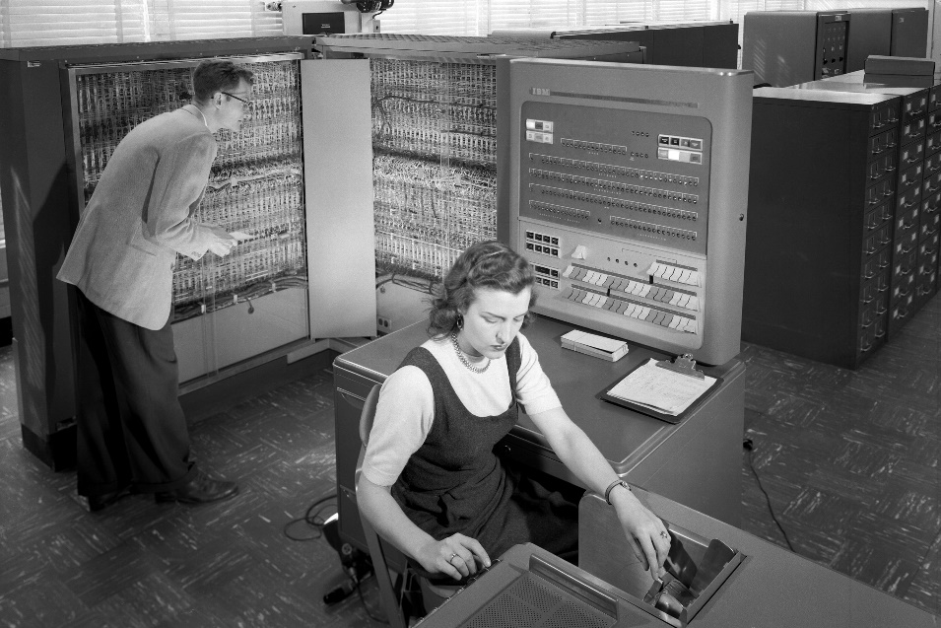
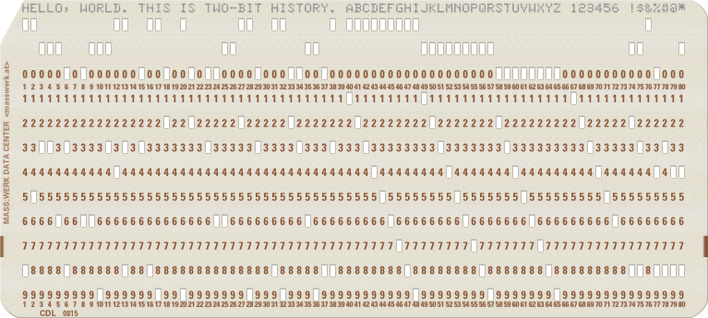
Batch Operating System
The users of a batch operating system do not interact with the computer directly. Each user prepares his job on an off-line device like punch cards and submits it to the computer operator. To speed up processing, jobs with similar needs are batched together and run as a group. The programmers leave their programs with the operator and the operator then sorts the programs with similar requirements into batches.
The problems with Batch Systems are as follows:
Lack of interaction between the user and the job.
CPU is often idle, because the speed of the mechanical I/O devices is slower than the CPU.
Difficult to provide the desired priority.

Slide 50
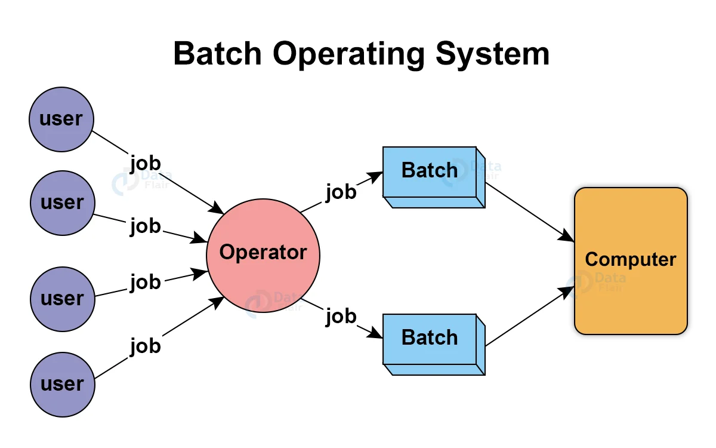

Slide 51
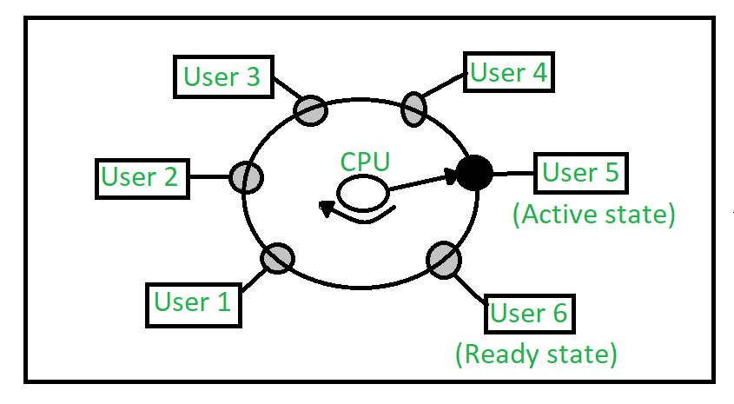
2. Time-Sharing / Multi-User OS
Allows multiple users to interact simultaneously.
CPU time is shared among users.
Examples: UNIX, Windows Server.

Slide 52
Advantages of Time-Sharing Operating Systems
Multiple Users Support
  Allows several users to use the system simultaneously.
Efficient CPU Utilization
  CPU time is shared among processes, reducing idle time.
Faster Response Time
  Users get prompt feedback as tasks are processed quickly in slices.
Interactive Computing
  Supports real-time interaction with applications.
Resource Sharing
  Hardware and software resources can be shared among multiple users.
Flexibility and Convenience
  Users can run programs without waiting for other jobs to finish.
Cost-Effective
  Multiple users can work on a single computer, reducing hardware costs.

Slide 53
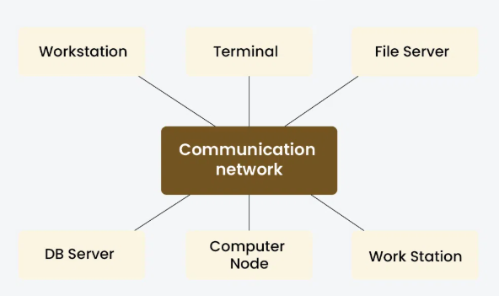
3. Distributed Operating System
Manages a group of independent computers as a single system.
Provides resource sharing and transparency.
Examples: Amoeba, Plan 9.

Slide 54
Advantages of Distributed Systems
Resource Sharing
  Multiple computers can share hardware, software, and data resources efficiently.
Scalability
  New nodes can be added easily to the network to increase computing power.
Reliability & Fault Tolerance
  Failure of one node does not crash the entire system.
  Redundancy ensures continuous operation.
Performance & Speed
  Tasks can be processed in parallel across multiple machines.
  Reduces execution time for large computations.
Flexibility
  Users can access resources from any location.
  Supports heterogeneous hardware and platforms.
Cost-Effectiveness
  Cheaper to connect multiple low-cost machines than to buy a single powerful computer.
Transparency
  Users perceive the system as a single coherent system, hiding the complexity of distribution.

Slide 55
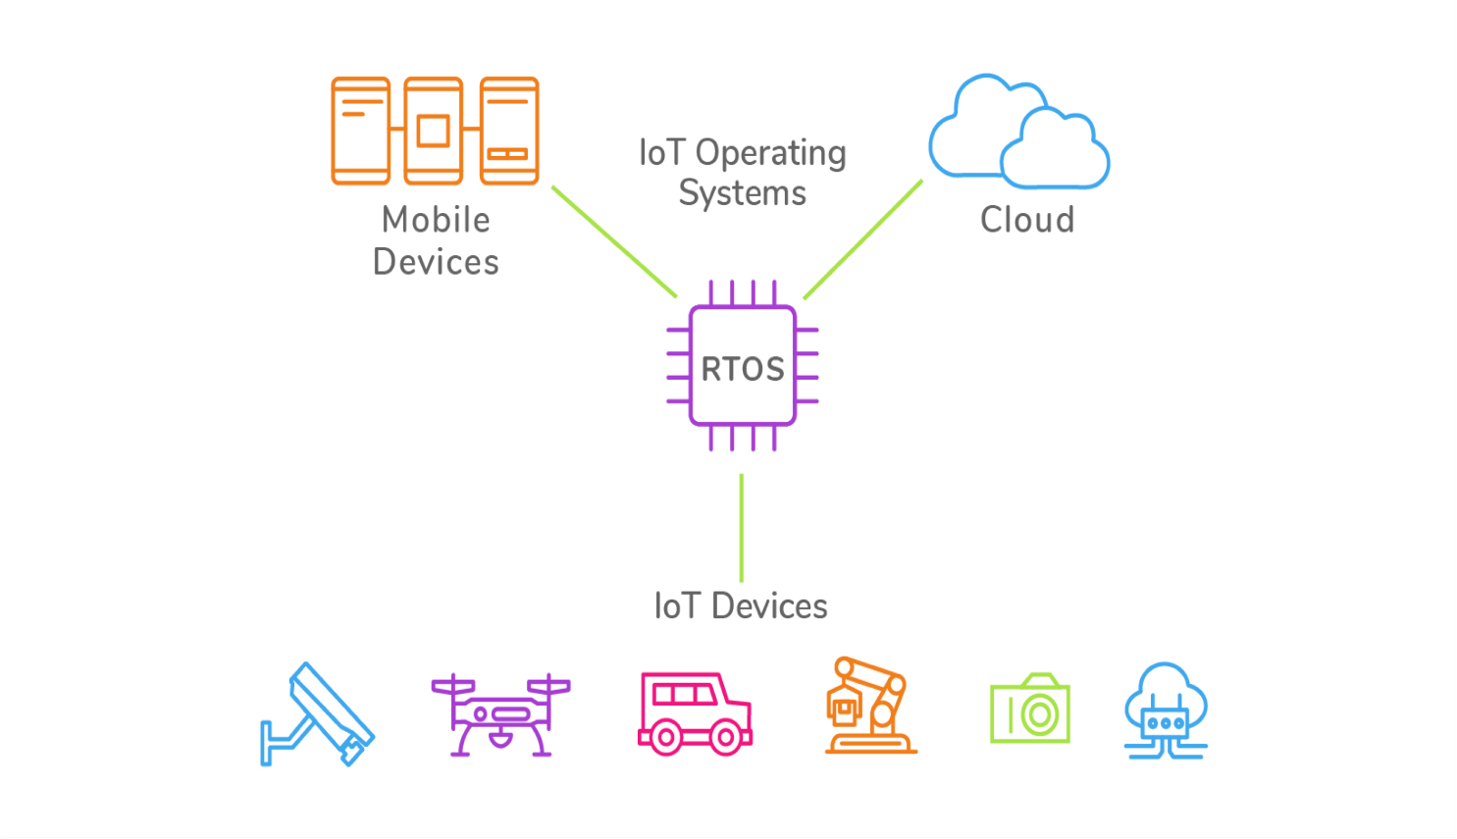
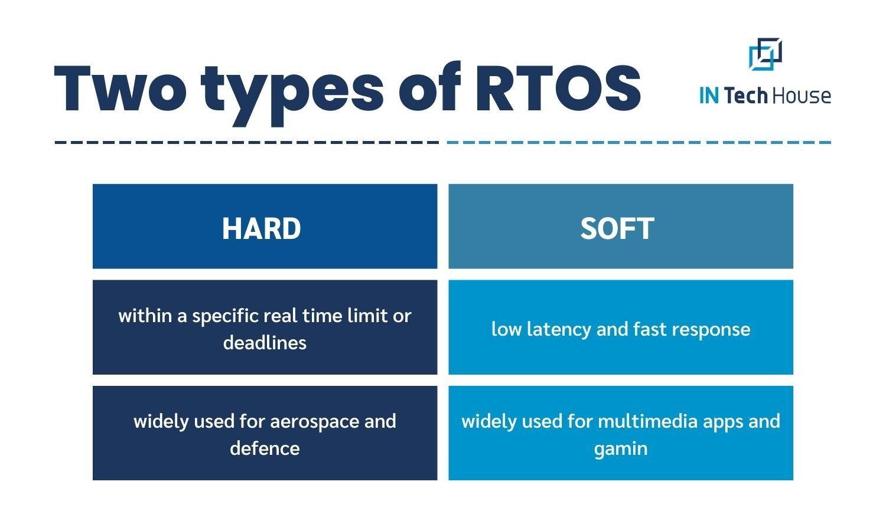
4. Real-Time Operating System (RTOS)
Responds to inputs immediately (within strict timing constraints).
Used in embedded systems, robotics, avionics.
Examples: VxWorks, FreeRTOS.

Slide 56
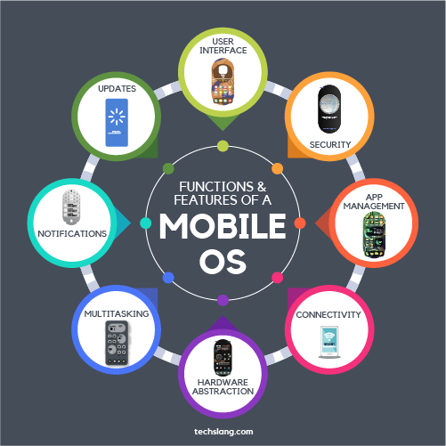
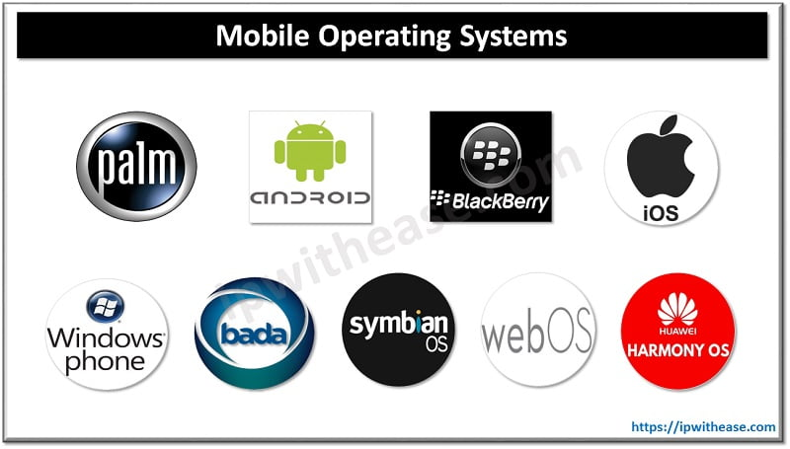
5. Mobile Operating System
Optimized for smartphones and tablets.
Examples: Android, iOS.

Slide 57
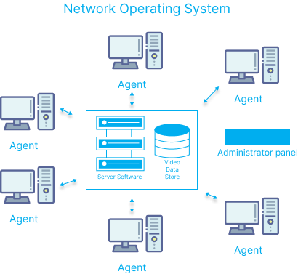
6. Network Operating System
Manages network resources and provides services over a network.
Examples: Novell NetWare, Windows Server.

Slide 58
Network Operating System (NOS)
Advantages:
Resource Sharing – Allows multiple computers to share files, printers, and other resources.
Centralized Management – Easier to manage users, security, and applications from a central server.
Security – Provides access control, authentication, and authorization.
Communication – Facilitates messaging, email, and collaboration among users.
Scalability – Can add more computers or users to the network with minimal disruption.
Disadvantages:
Cost – Requires expensive hardware, software, and network infrastructure.
Maintenance – Needs skilled administrators for network management.
Dependency – If the server fails, clients may lose access to resources.
Security Risks – Centralized systems can be targeted by attacks.
Performance Bottlenecks – Heavy network traffic can slow down operations.

Slide 59
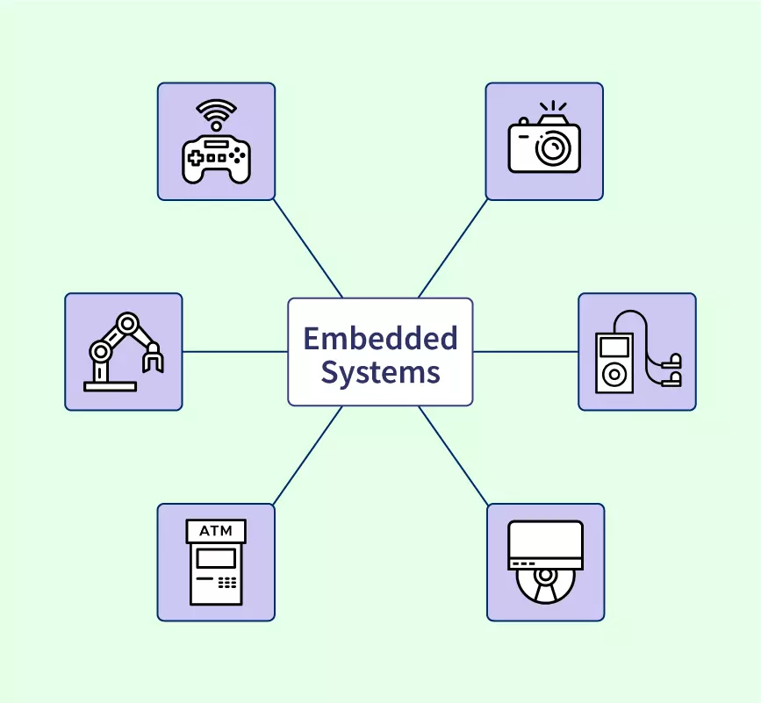
7. Embedded Operating System
Lightweight OS for specific hardware tasks.
Found in routers, appliances, IoT devices.
Examples: Embedded Linux, QNX.

Slide 60
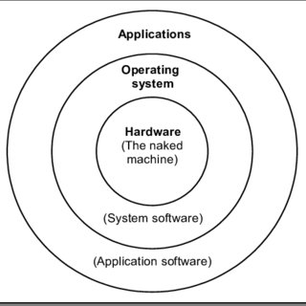
OPERATING SYSTEM STRUCTURE

Slide 61
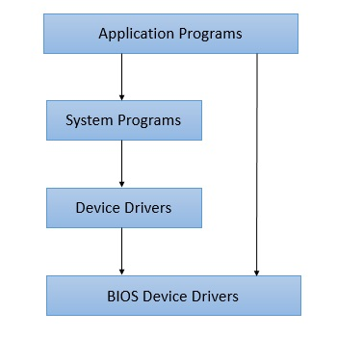
1. Simple Structure
There are many operating systems that have a rather simple structure. These started as small systems and rapidly expanded much further than their scope. A common example of this is MS-DOS.

Slide 62
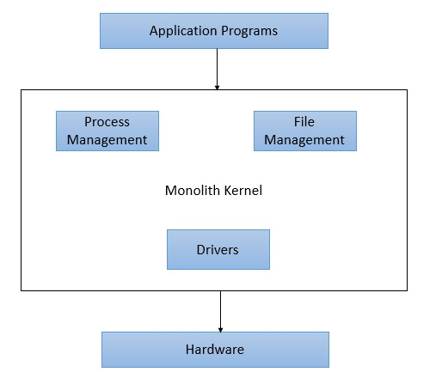
2. Monolithic Structure
All OS functions in a single large program
Pros: High performance
Cons: Hard to maintain/debug

Slide 63
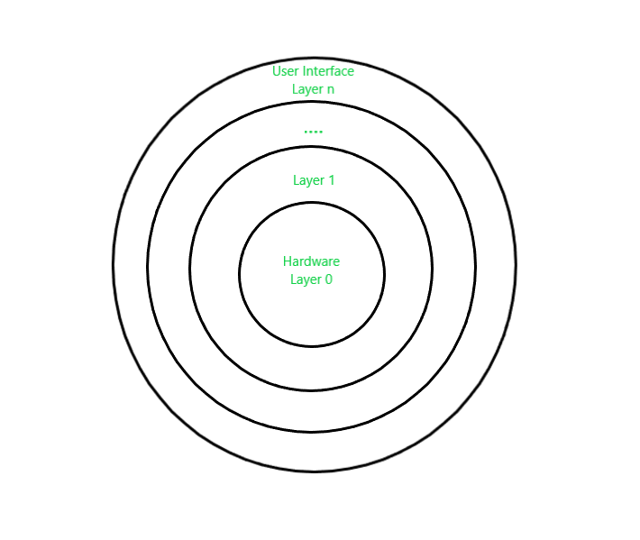
3. Layered Structure
Divided into layers, each built on lower ones
Pros: Modular, easier to debug
Cons: Slight performance overhead

Slide 64
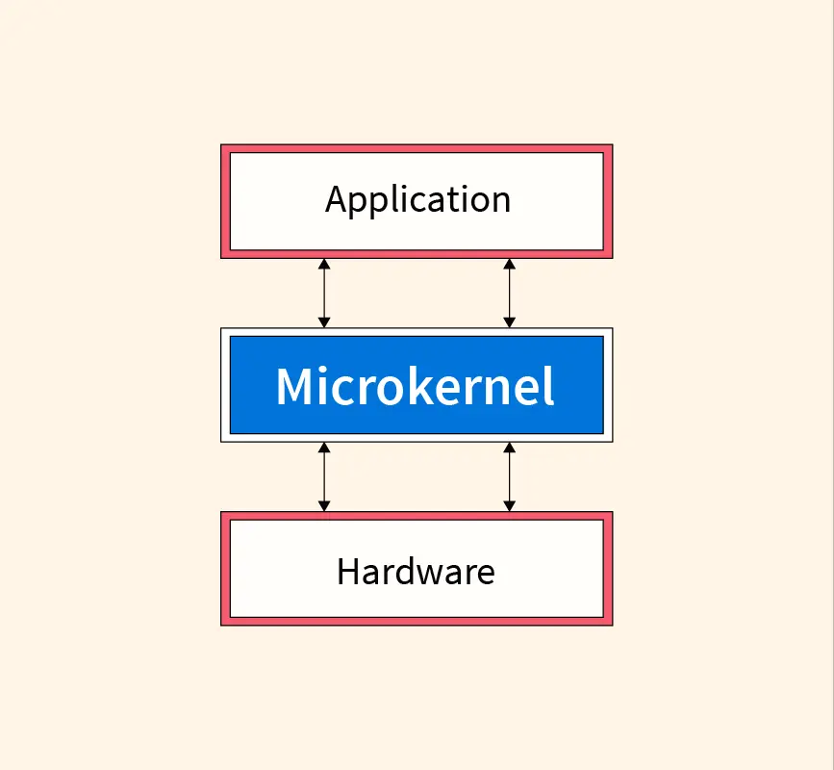
4. Microkernel Structure
Only essential services in kernel; others run in user space
Pros: Reliable, secure, modular
Cons: Context switching overhead

Slide 65
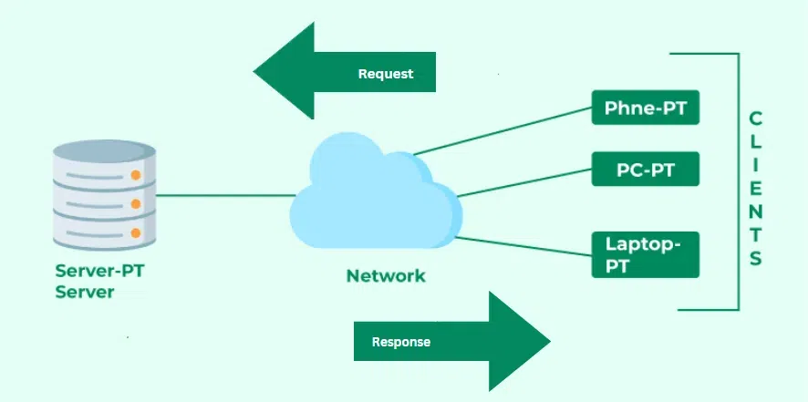
5. Client-Server Structure
OS services as servers; clients request services
Pros: Scalable, clear separation
Cons: Communication overhead

Slide 66
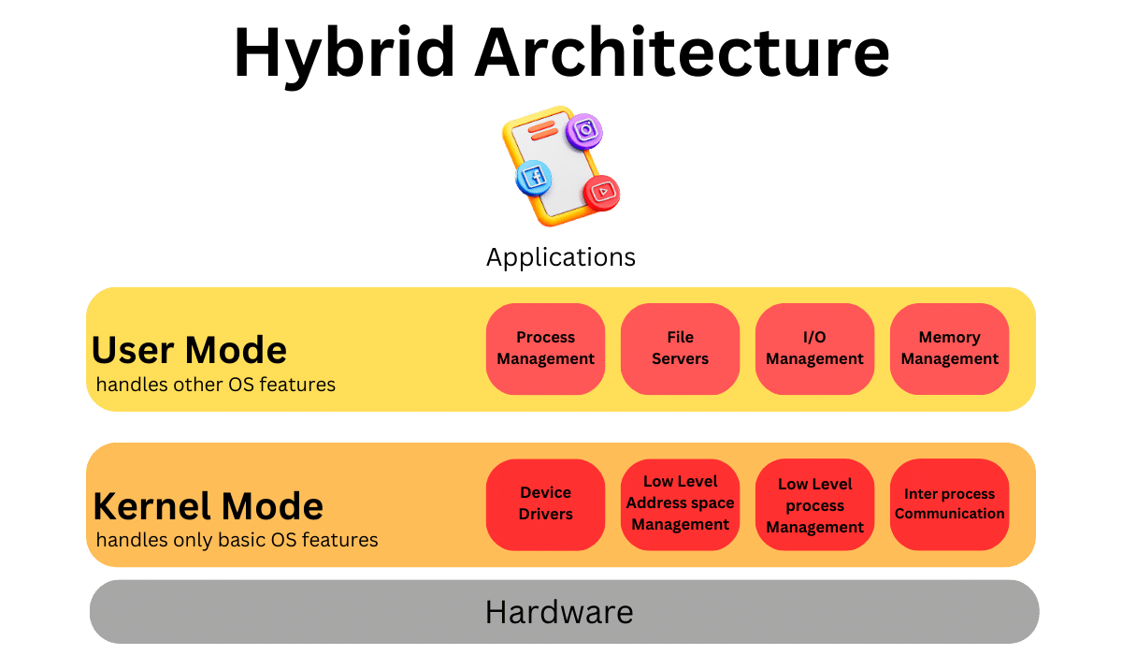
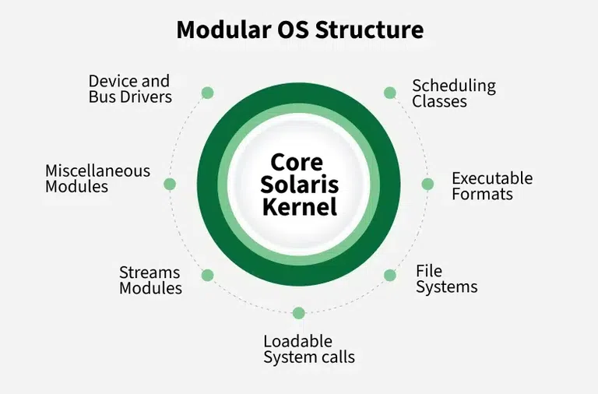
6. Layered + Modular / Hybrid Structure
Combines advantages of layers and modules.
Modern OSs (Windows, Linux) use hybrid structures.

Slide 67
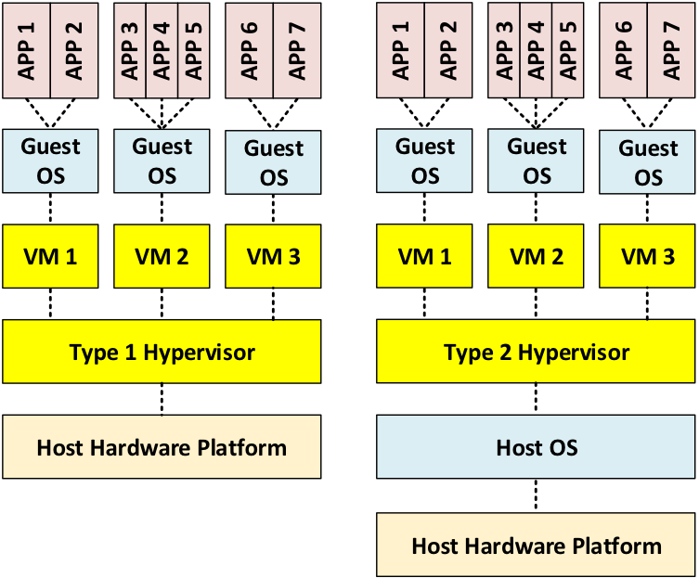
6.Virtualization / Virtual OS
Run multiple OS instances on the same hardware using VMs/hypervisors.
Pros: Resource sharing, isolation, easy testing.
Examples: VMware, VirtualBox, Hyper-V

Slide 68
Important Terms in Operating Systems
Process – A program in execution, including its current state and resources.
Thread – The smallest unit of CPU execution within a process.
Kernel – The core part of the OS, managing resources and system calls.
System Call – A request by a program to the OS for a service.
Interrupt – A signal that temporarily halts CPU to handle urgent tasks.
Scheduler – Determines which process gets CPU time and in what order.
File System – Organizes and manages files and directories on storage devices.
Device Driver – Software that allows the OS to communicate with hardware devices.

Slide 69
Cont’
Virtual Memory – Uses disk space to extend the apparent RAM capacity.
Swapping – Moving processes between main memory and secondary storage.
Deadlock – A state where two or more processes cannot proceed because each is waiting for the other.
Multitasking – Running multiple tasks/processes seemingly simultaneously.
Multiprogramming – Keeping multiple programs in memory to maximize CPU usage.
Real-Time System – An OS that guarantees immediate response for critical tasks.
User Interface (UI) – The part of OS that allows users to interact (CLI, GUI).

Slide 70
Lesson 2

Slide 71

Thank you
For I know the thoughts that I think toward you, saith the LORD, thoughts of peace, and not of evil, to give you an expected end. Jeremy 29:11

